Slide 1
Power Reduction Techniques in AHB Lite Interface & AXI4 to AHB Bus
V.SRAVANTHI
DESIGN ENGINEER
CHIPWEAVE TECHNOLOGIES PVT LTD

Slide 2
CONTENTS
Introduction
Gray Code Encoding In AHB Lite Interface
Bus Inversion Encoding and Decoding In AHB Lite Interface
Gray Code Encoding In AXI4 to AHB bridge
Bus Inversion Encoding and Decoding In AXI4 to AHB bridge

Slide 3
Introduction
Gray Code: We can Apply on FSM state encoding or asynchronous pointer/address crossing in the AXI4-to-AHB-Lite bridge to reduce switching and avoid metastability.
Bus Inversion: Apply on AHB address/data buses (HADDR, HWDATA) before transmission to reduce bit transitions and dynamic power.
Transition Inversion (T0 Coding): Apply on sequential address transfers in the AHB interface to minimize transitions when addresses increase consecutively (burst transfers). But in this case address is incremented by 4 so T0 encoding is not possible.

Slide 4
Gray Code Encoding in AHB-Lite Interface
We can use Gray code in the AHB-Lite control FSM by encoding the transaction states (IDLE, DECODE, ACCESS, RESPONSE) such that only one bit changes between consecutive states.
This reduces switching activity and dynamic power consumption in the control path and minimize glitches during state changes, improving reliability.
HSEL[0]
Responder 0
AHB Initiator
Address Decoder
(Existing Code)
Control FSM
(Gray Code)
HSEL[1]
Responder 1
HSEL[N]
Responder N
Fig 1. Gray Code in AHB-Lite Interface

Slide 5

Gray Code Encoding Steps in AHB-Lite Interface
Step 1: AHB transaction starts when HTRANS = NONSEQ and a valid address arrives.
Step 2: The controller enters a Gray-coded FSM state:
IDLE = 00
BUSY = 01
NON SEQ = 1
SEQ = 10
Step 3: During transaction processing, the FSM changes as: 00 → 01 → 11 → 10 → 00
Only one bit changes in each transition.
Step 4: The FSM generates control signals such as HSEL, HREADY, and HRESP based on the current state.
Step 5: Because only one bit toggles per state change, switching activity, glitches, and power consumption in the control logic are reduced.

Slide 6
Bus Inversion Encoding
Bus inversion is used in an AHB-Lite interface mainly to reduce dynamic power consumption caused by frequent switching of wide buses like:
hwdata
hrdata
AHB-Lite data buses are usually 32-bit or 64-bit wide. During every transfer many bits toggle between 0 and 1.
Bus inversion reduces the switching activity α.

Slide 7
Steps in Bus Inversion Encoding
Start
Current Data
Compare with Previous data
Count Transition Bits
Transitions > width/2
Yes
No
Invert Data and INV=1
Send Original data INV=0
Transmit data + INV Bit
Receiver Checks Invert Bit
Recover Original Data
End
Fig 1. Bus Inversion Flow

Slide 8
Bus Inversion Encoding & Decoding in AHB Lite Interface
Start
Select Current AHB Lite Data
Compare with Previous data
Count Transition Bits
Transitions > width/2
Invert Data and INV=1
Yes
No
Send Original data INV=0
Transmit data + INV Bit
Receiver Checks Invert Bit
Recover Original Data
End
Fig 2. Bus Inversion Flow in AHB Lite Interface

Slide 9
Example Of Bus Inversion Encoding in AHB Lite Interface
1. Previous hwdata: 32'hAAAAAAAA
2. Current hwdata : 32'h55555555
3. Compare transitions between previous and current data
4. Total transitions: 32 transitions
5. Check condition(32 > 16) ? invert current hwdata: Original Data
7. Transmit: hwdata = 32'hAAAAAAAA and INV = 1
8. Receiver checks INV=1 and recovers 32'h55555555

Slide 10
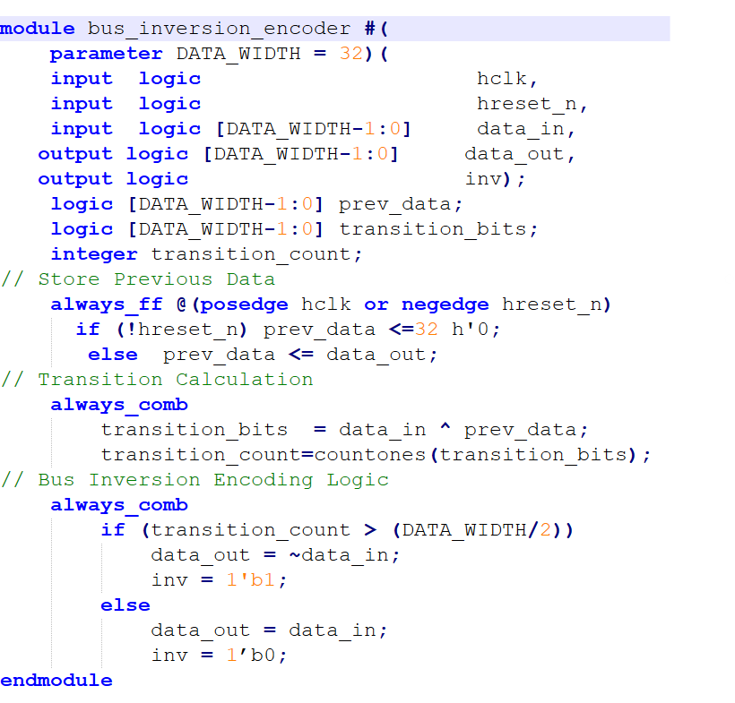
Bus Inversion Encoding Logic In AHB Lite Interface

Slide 11
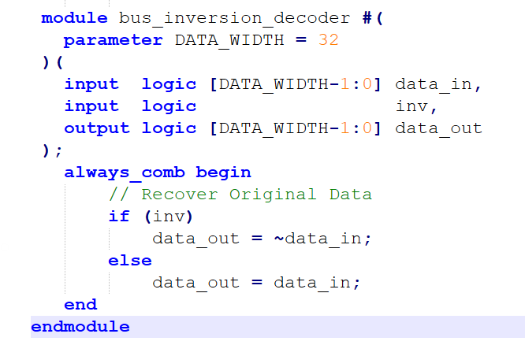
Bus Inversion Decoding Logic In AHB Lite Interface

Slide 12
Transition Inversion Introduction
Transition inversion is a low-power technique used to reduce switching activity on high-speed buses.
WHY?
If too many bits change between consecutive data, invert the current data before transmission.
Transition inversion reduces switching activity (α)
We can Calculate the transition pattern using XOR: T=P⊕C
Where:
P = Previous bus value
C = Current bus value
T = Transition pattern

Slide 13
Transition Inversion Encoding & Decoding in AHB Lite Interface
Start
Select Current AHB Lite Data
Compare with Previous data
XOR Operation between them
Transitions > width/2
Yes
No
Invert Data and INV=1
Send Original data INV=0
Transmit data + INV Bit
Receiver Checks Invert Bit
Recover Original Data
End
Fig 3. Transition Inversion Flow in AHB Lite Interface

Slide 14
Transition Inversion Encoding and Decoding Logic In AHB Lite Interface
always_comb begin transition_count = 0; for (i = 0; i < DATA_WIDTH; i = i + 1) // Compare transitions if (data_in[i] != prev_data[i]) transition_count = transition_count + 1;
always_comb if (transition_count > (DATA_WIDTH/2)) data_out = ~data_in; inv = 1'b1; else data_out = data_in; inv = 1'b0; endmodule
module ahb_transition_inversion_encoder #( parameter DATA_WIDTH = 32 )( input logic hclk, input logic hreset_n, input logic [DATA_WIDTH-1:0] data_in, output logic [DATA_WIDTH-1:0] data_out, output logic inv );
logic [DATA_WIDTH-1:0] prev_data; integer transition_count; integer i;
always_ff @(posedge hclk or negedge hreset_n) begin if (!hreset_n) prev_data <= '0; else prev_data <= data_out;

Slide 15
Transition Inversion Decoding Logic In AHB Lite Interface
module ahb_transition_inversion_decoder #(
parameter DATA_WIDTH = 32
)(
input logic [DATA_WIDTH-1:0] data_in,
input logic inv,
output logic [DATA_WIDTH-1:0] data_out
);
always_comb
if (inv) data_out = ~data_in;
else data_out = data_in;
endmodule

Slide 16
Power Reduction techniques in AXI4 to AHB Bus
Control Path
AXI Address
Handler
Burst Counter
(Gray code)
Address generator
FSM
(Gray code)
AHB Control logic
Write Data Path
AXI
WDATA
Handler
Bus
Inversion Encoder
Write data
FIFO
(Gray code)
Bus Inversion Decoder
AHB Output logic
Fig 4. Power Reduction techniques in AXI4 to AHB Bus

Slide 17
Gray Code Encoding in AXI4 to AHB Bus
Gray coding in the AXI4-to-AHB bridge is used to reduce switching activity in the FSM (Finite State Machine).
The bridge FSM controls AXI read/write transactions and AHB transfers using states such as : IDLE- CMD_RD- DATA_RD -CMD_WR -DATA_WR -DONE_RD -DONE_WR

Slide 18
Gray Code Encoding Steps in AXI4 to AHB Bus
Step 1: Identify FSM states in AXI-to-AHB bridge : IDLE, CMD_RD, DATA_RD, DONE_RD
Step 2:Check normal binary encoding
IDLE = 0000
CMD_RD = 0001
DATA_RD = 0010
DONE_RD = 0011
Step 3:Observe multiple bit transitions:0001 -> 0010(2 bits change)
Step 4:Assign Gray-coded values
IDLE = 0000
CMD_RD = 0001
DATA_RD = 0011
DONE_RD = 0010
Step 5: only one bit changes 0001 -> 0011(1 bit change)

Slide 19
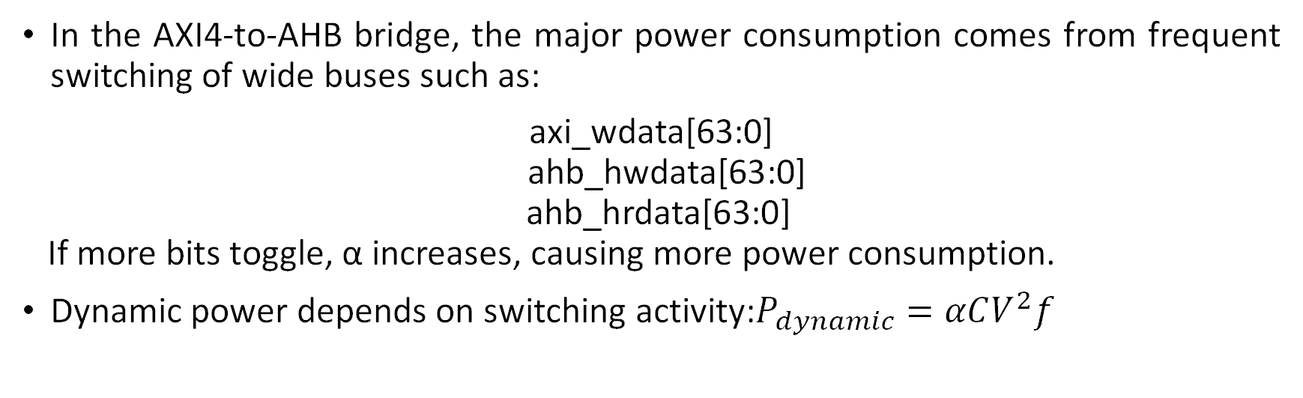
Bus Inversion Encoding in AXI4 to AHB Bus
In the AXI4-to-AHB bridge, the major power consumption comes from frequent switching of wide buses such as:
axi_wdata[63:0] ahb_hwdata[63:0] ahb_hrdata[63:0] If more bits toggle, α increases, causing more power consumption.
Dynamic power depends on switching activity:$P_{dynamic}=αCV^{2}f$

Slide 20

Bus Inversion Encoding in AXI4 to AHB Bus
Without Bus Inversion:
Apply encoder here:
Store : buf_data and inv_bit
Decode before AHB output:
wrbuf_data
Bus Inversion Encoder
encoded_data + inv_bit
buf_data + inv_bit
Bus Inversion Decoder
AHB_hwdata

Slide 21
Example Of Bus Inversion Encoding in AXI4 to AHB Bus
Let Previous Data = 64'h0000_0000_0000_0000 Current Data = 64'hFFFF_FFFF_FFFF_FFFF
Transitions = 64
Since 64 > 32:
Send: encoded_data = 64'h0000_0000_0000_0000 inv_bit = 1
Receiver:
inv_bit = 1 decoded_data = ~(encoded_data) = FFFF_FFFF_FFFF_FFFF

Slide 22


